Slide 1
Matrices and determinants
Matrices and operations on them.
Two- and three-order determinants
Basic properties of the determinant.
Practice
.

Slide 2
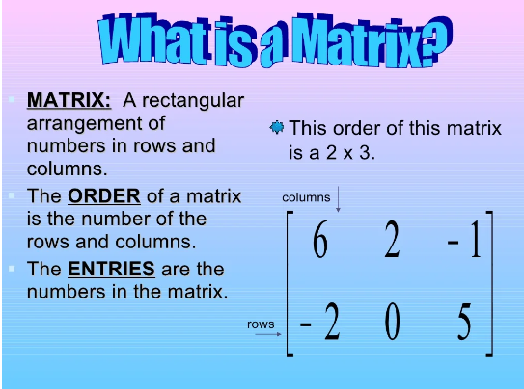

Slide 3
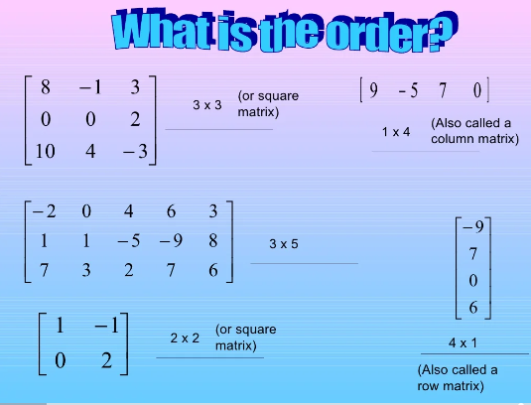

Slide 4
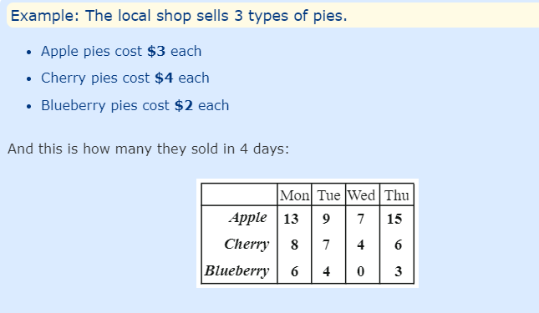

Slide 5
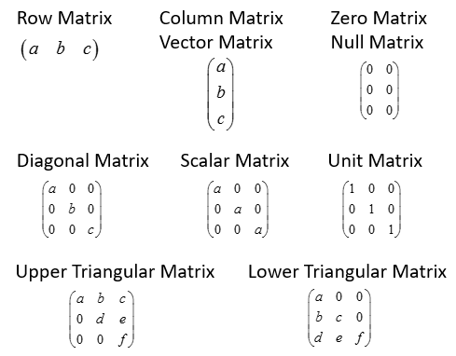
Types of matrices

Slide 6
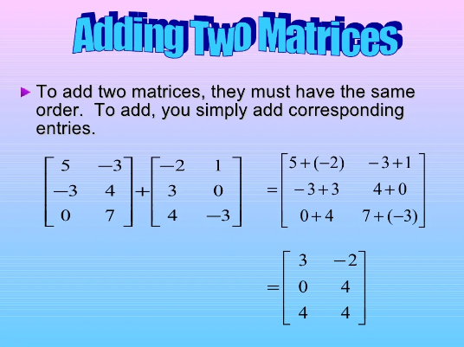

Slide 7
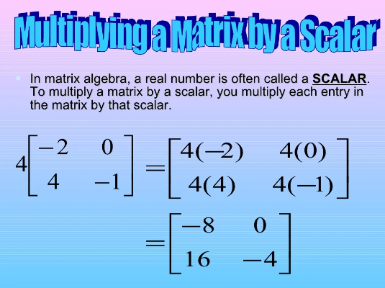

Slide 8
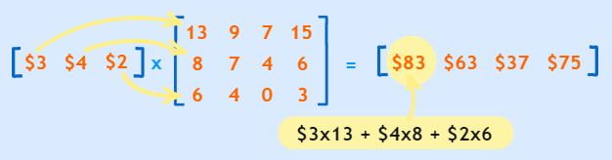

Slide 9
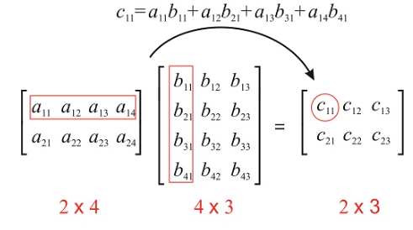
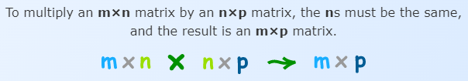
Matrix multiplication

Slide 10
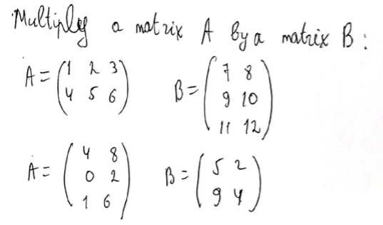
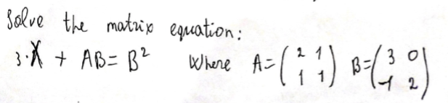
Practice

Slide 11
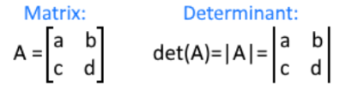


DETERMINANT

Slide 12


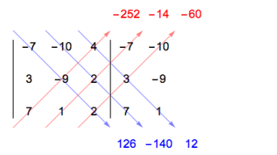
DETERMINANT OF THREE-BY-THREE MATRIX

Slide 13




PROPERTIES OF DETERMINANT

Slide 14
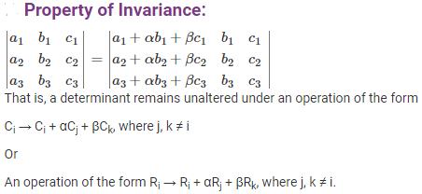
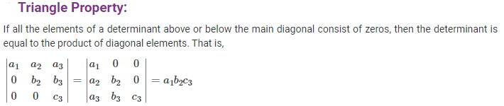
PROPERTIES OF DETERMINANT

Slide 15
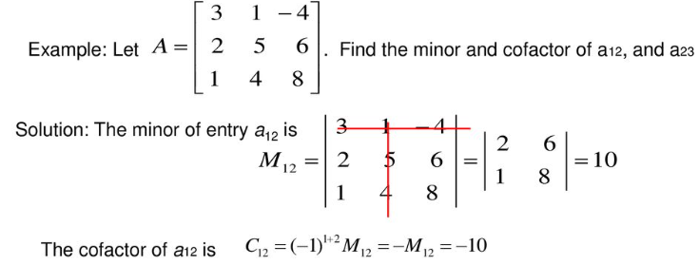
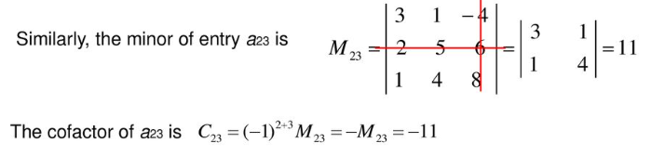
Minor and Cofactor

Slide 16
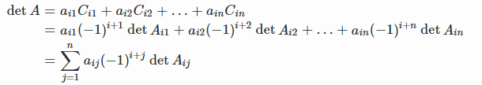
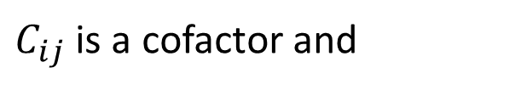
Laplace expansion or Cofactor expansion
$$C_{ij}={(−1)}^{i+j}M_{ij}$$
$C_{ij}$ is a cofactor and

Slide 17
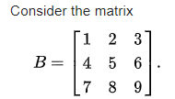


the Laplace expansion along the first row yields
Laplace expansion along the second column yields the same result

Slide 18

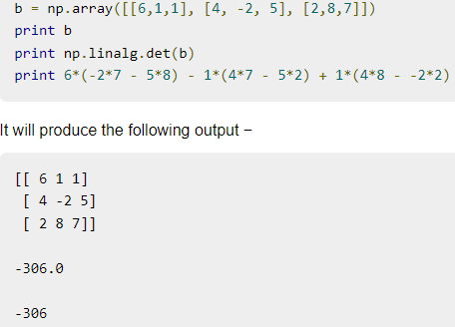

NumPy - Determinant

Slide 19
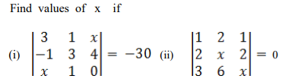
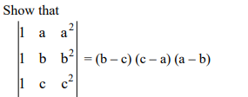
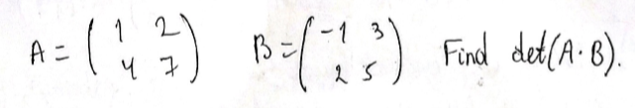
Practice

